Slide 1
SQL & Python
By AppJedi
www.appjedi.net

Slide 2
SQL & Python introduction
Python and SQL work together by having Python act as the application that communicates with the database. Python sends SQL commands to MySQL to retrieve, add, update, or delete data, and MySQL sends the requested results back to Python for the program to use or display.

Slide 3
SQL & Python
Python controls your program.
SQL tells the database what information you want.
Python sends the SQL command to MySQL.
MySQL sends the results back to Python.

Slide 4
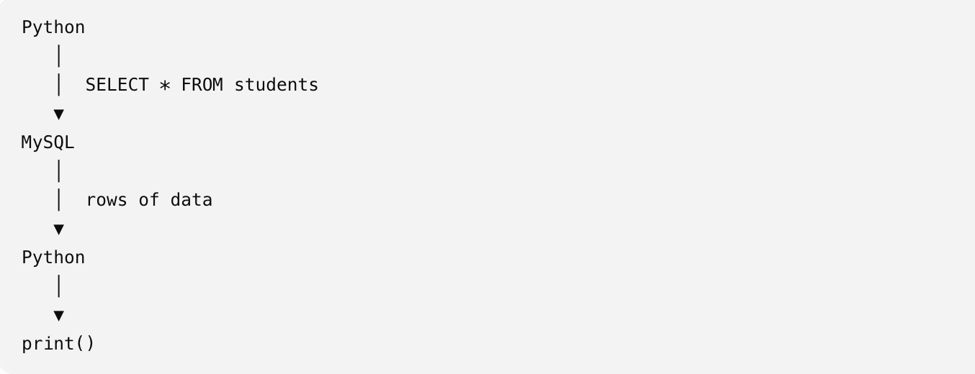
The Basic Flow:

Slide 5
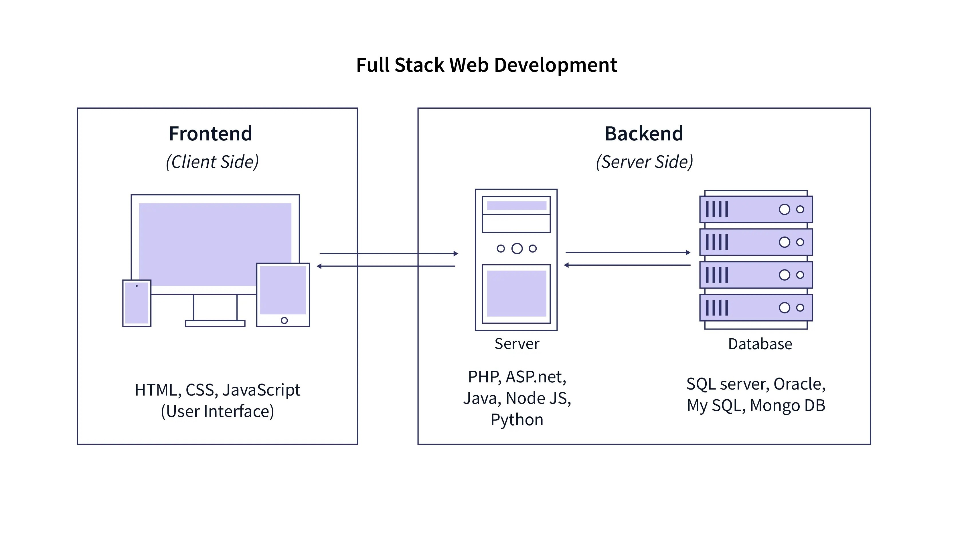

Slide 6
Python SQL example:
import mysql.connector
# Connect to MySQL
db = mysql.connector.connect(
host="localhost",
user="root",
password="mypassword",
database="school" )
# Create a cursor
cursor = db.cursor()

Slide 7
Prepared Statement
# Run SQL
cursor.execute("SELECT * FROM students")
# Get results
results = cursor.fetchall()
# Display results
for row in results:
print(row)
# Close everything
cursor.close()
db.close()

Slide 8
Stored Procedure
cursor = conn.cursor()
cursor.callproc("usp_user_auth", [username,password])
for result in cursor.stored_results():
row = result.fetchone()
break
print(row)
cursor.close()
conn.close()

Slide 9
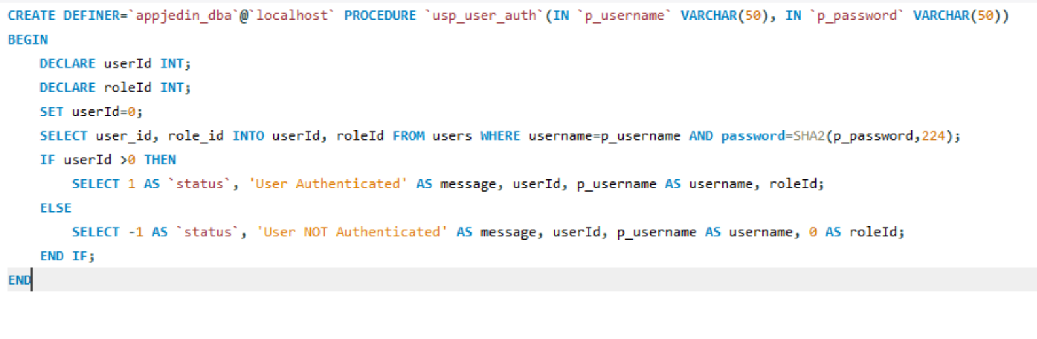
Stored Procedure

Slide 10
Next
Next

